Slide 1

Tutorial Plan
How To Name A Package
How To Name A Class
How To Name A Method
How To Name A Variable
Questions, Answers, & Practice

Slide 2
Tutorial Plan
How To Name A Package
How To Name A Class
How To Name A Method
How To Name A Variable
Questions, Answers, & Practice

Slide 3
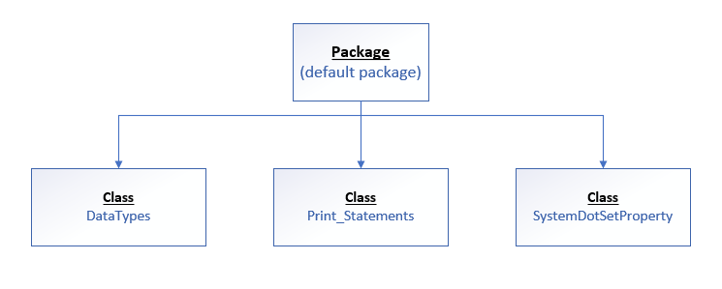
Classes Organized Into A Default Package

Slide 4
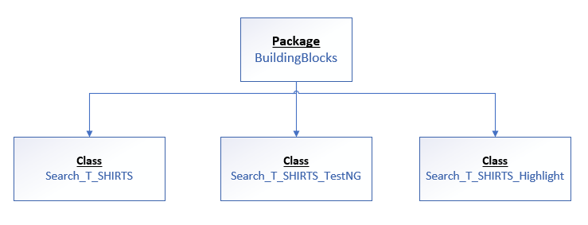
Classes Organized Into A Named Package

Slide 5
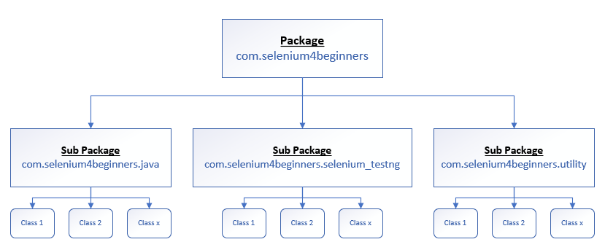
Sub Packages Organized Into A Package

Slide 6
Tutorial Plan
How To Name A Package
How To Name A Class
How To Name A Method
How To Name A Variable
Questions, Answers, & Practice

Slide 7
Data Types
Data Types
Primitive
(Non-Object)
Class
(Object)
Notes:
Explain that Primitive Data Types are called many names then state the other names

Slide 8
Tutorial Plan
How To Name A Package
How To Name A Class
How To Name A Method
How To Name A Variable
Questions, Answers, & Practice

Slide 9
Method Components
Syntax
modifier returnType methodName (parameter-list)
{
// Method Body
}

Slide 10
Non Object & Object Data Types
Non Object
Object
int
double
boolean
String
WebDriver
WebElement

Slide 11
Tutorial Plan
How To Name A Package
How To Name A Class
How To Name A Method
How To Name A Variable
Questions, Answers, & Practice

Slide 12
Variable Declaration
Syntax
DataType variableName;
Argument | Description
DataType | Data type of variable being declared
variableName | Name of variable being declared
; | Semi-colon completes the declaration statement

Slide 13
Variable Rules & Conventions
Rules
Can contain letters, numbers, dollar sign ($), and underscore (_)
Can begin with a letter, dollar sign ($), or underscore (_)
Cannot contain a space or special character except dollar sign ($) or underscore (_)
Conventions
Construct a descriptive name that describe the variable’s purpose
Compose names utilizing the lowerCamelCase syntax. All letters are lowercase if there is only one word
Create a name that begins with a letter

Slide 14
Java’s 50 Reserved Keywords
abstract | continue | for | new | switch
assert | default | goto | package | synchronized
boolean | do | if | private | this
break | double | implements | protected | throw
byte | else | import | public | throws
case | enum | instanceof | return | transient
catch | extends | int | short | try
char | final | interface | static | void
class | finally | long | strictfp | volatile
const | float | native | super | while
Notes:
1. Fade the words that are not Data Types. The video shows how to display a row but I will customize to display certain words
https://www.youtube.com/watch?v=fip-RdJgsFA
2. Highlight the Data Types within the 50 Reserved Words
https://www.youtube.com/watch?v=340fjTB-na8

Slide 15
Naming Conventions Summary
Name | Convention
package | All letters are lowercase.
class | A noun that starts with an uppercase letter using the CamelCase syntax. Each word begins with an uppercase letter.
method | A verb or verb phrase that starts with a lowercase letter using the lowerCamelCase syntax. Every subsequent word begins with an uppercase letter.
variable | A descriptive word that starts with a lowercase letter using the lowerCamelCase syntax. Every subsequent word begins with an uppercase letter.

Slide 16
Tutorial Plan
How To Name A Package
How To Name A Class
How To Name A Method
How To Name A Variable
Questions, Answers, & Practice

Slide 17
Questions, Answers, & Practice
How do you create a sub package?
Can a class name include numbers?
What is the convention for a Method?

Slide 18
Questions, Answers, & Practice
How do you create a sub package? A sub package is created using a dot after the package name.
Can a class name include numbers? Yes, a class name can include numbers but it cannot start with a number.
What is the convention for a Method? The convention for a method is to follow a lowerCamelCase syntax by way of a verb phrase.

Slide 19
Questions, Answers, & Practice
If You Have Time, Watch This Video Conventional Naming In Java At Least One More Time
Create some sub packages that include a utility sub package
Read the code from Search_T_SHIRTS_Highlight and see if you understand how to highlight web elements. If you understand how to highlight web elements then highlight each element in your Test Script VerifyDemoWebShop_Email_Logout

